Slide 2
What is Winlink
Worldwide system for sending e-mail via radio.
Provides e-mail from almost anywhere in the world.
Entirely supported and operated by amateur radio volunteers (Amateur Radio Safety Foundation, Inc.).
RMS Express software is the preferred client application.
Adopted for contingency communication by many government agencies.
Used by infrastructure-critical NGOs such as International & American Red Cross, Southern Baptist Disaster Relief, DHS Tiered AT&T Disaster Response & Recovery, FedEx, Bridgestone Emergency Response Team, etc.

Slide 3
Winlink Connection Modes
Telnet – Non-radio connection through the Internet. Good
for training (no radio equipment required) and use if radio is down or network is busy.
VHF/UHF Packet (local LOS propagation) –
9600 baud – Fast, reliable, range limited and requires $400
modem (Kantronics or SCS Tracker). Radio must be 9600 capable.
1200 baud – Slower, but can use inexpensive TNC like Byonics TinyTrak-4, TNC-X, or even soundcard modems. Will work with virtually any FM radio.

Slide 4
Winlink Connection Modes
HF WINMOR – “Poor man’s Pactor”. Not as good as Pactor, but operates with an inexpensive sound card device ($100), speeds between Pactor 2 and 3.
HF Pactor 1, 2, 3 and 4 – Fast and reliable but requires an expensive modem ($1500+).
All RF modes can be Peer-to-Peer.

Slide 5
Resources Needed for RMS Express VHF/UHF Packet Radio
Computer running Windows XP through Windows 10.
Microsoft .NET 3.5 framework.
V/UHF radio with data port (1200/9600) or speaker/mic connection (1200 only).
Packet TNC (Kantronics, TNC-X, MFJ, etc.), or SignaLink or similar USB soundcard interface. Might require a USB to Serial dongle.
Note: Some new radios have built-in soundcards/TNC’s.
Software downloads:
ftp://autoupdate.winlink.org/User%20Programs/
All software is free, donation is suggested.

Slide 6
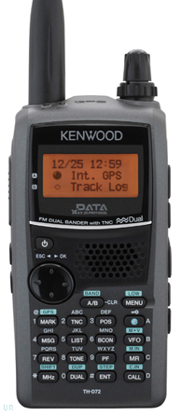
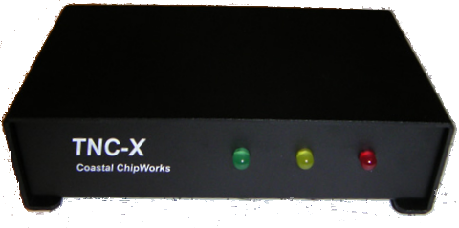
Packet TNC
Can be simple KISS mode, or full function.
Cost from about $100 to $1500.
Radio needs to have a data port (1200/9600), or use microphone and speaker connections (1200 only).
Some radios include a built-in TNC or sound card.
Might require a USB to serial adapter (built-in on TNC-X)
Use FTDI chipset devices for best results

Slide 7
Packet TNC
Prolific chipset USB to serial converters have driver issues.
Counterfeit Chinese products used Prolific product ID and “piggy backed” on official Prolific drivers.
Prolific countered by changing the hardware/drivers so the counterfeit devices would not work with their drivers.
This website may help: http://www.ifamilysoftware.com/news37.html
Adapters based on the FTDI chipset do not have this problem (yet anyway).

Slide 8
SignaLink Soundcard Interface
Simple device powered by USB connection.
Cost is about $100 including radio-specific cable.
Radio needs to have a data (sound) port, or use microphone and speaker connections.
Need to run “Software TNC” application such as Direwolf, or UZ7HO soundmodem.

Slide 9
Hardware TNC or Sound Card? There are advantages to both
Hardware TNC
Relatively low cost (TNC-X), old one in the closet?
Probably the simplest connection.
No additional software needed.
Sound Card
Can be used for other digital modes besides Winlink.
Software TNC has superior decode over older hardware TNC.
Can be used for both Packet and Winmor.

Slide 10
Hardware TNC or Sound Card? There are disadvantages to both
Hardware TNC
Only does packet (or maybe Pactor too).
Older units do not perform as well, no new development.
Will require USB to serial adapter.
Sound Card
Sound levels and other settings may be changed unexpectedly.
Requires additional software, and a slightly more complex operation (more training?).

Slide 11
Installing RMS Express
Download zip file:
ftp://autoupdate.winlink.org/User%20Programs/
www.winlink.org – Client Software, RMS Express
Watch for false downloads
Extract the .msi installer from the zip file and run it.
Complete the setup screens (call sign, location, etc.).
Browse C:\RMS Express\, right click on.
RMS Express.exe and select option to create a shortcut.

Slide 12
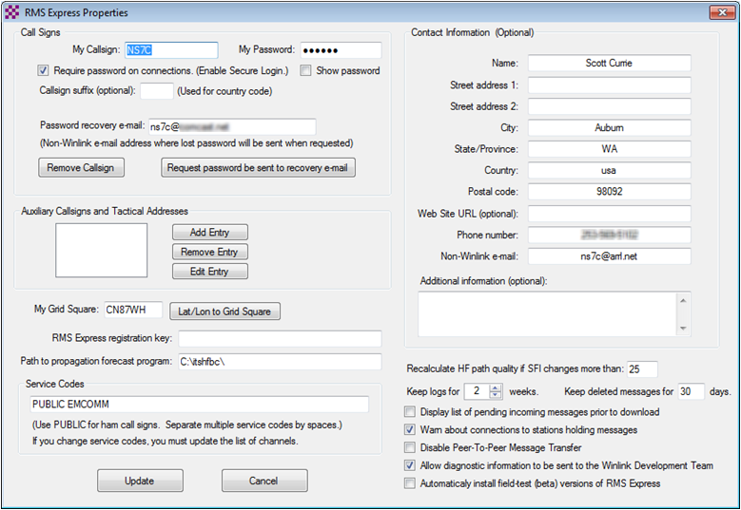
RMS Express Initial Setup

Slide 13
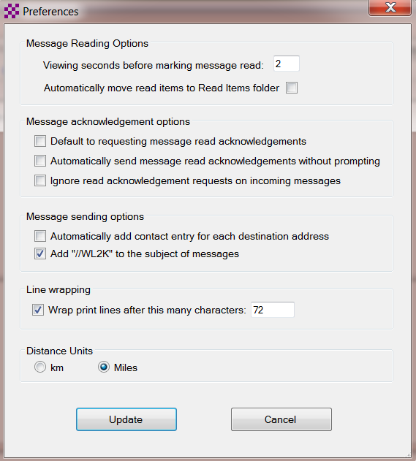
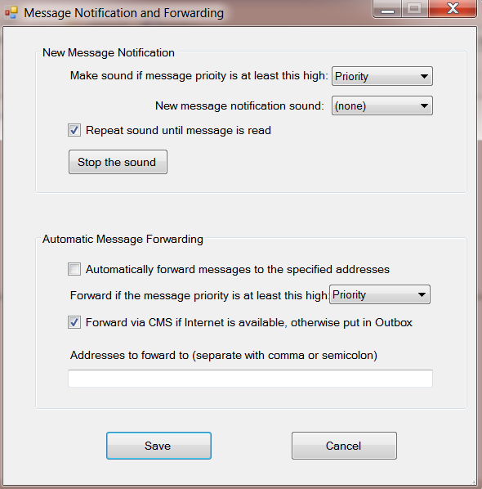
User Preferences
Click “Files” followed by “Preferences/Message Notification”

Slide 14
Installing RMS Express
The first time you originate a message using RMS Express, you will be registered in the Winlink system and will have a callsign@winlink.org address. This account remains active as long as you use is regularly. Inactive accounts will be purged after about 1 year.
You will also have access to the Winlink Webmail system and other good tools on the Winlink.org website.

Slide 15
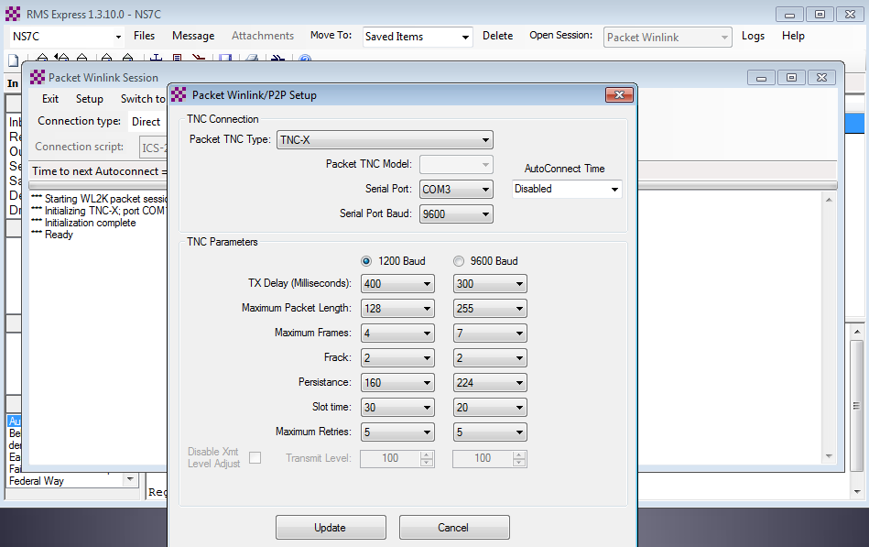
Initial Packet Setup Hardware TNC

Slide 16
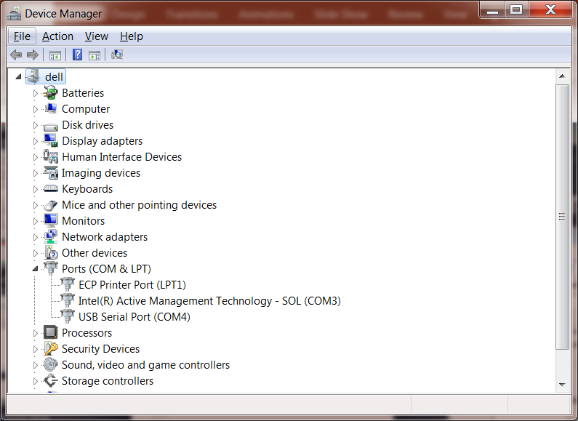
Initial Packet Setup Hardware TNC COM Port

Slide 17
Initial Packet Setup Sound Card Interface
Download zip file (UZ7HO):
http://uz7.ho.ua/modem_beta/soundmodem94.zip
Extract the program from the zip file and run it.
Configuration settings from the drop down menus.
Windows only, firewall message.
Download zip file (Direwolf):
https://github.com/wb2osz/direwolf/releases/download/1.3-dev-K/direwolf-1.3-dev-K-win.zip
Extract the program files from the zip file and run the app.
Edit the INI file to configure.
Multi-platform capable.

Slide 18
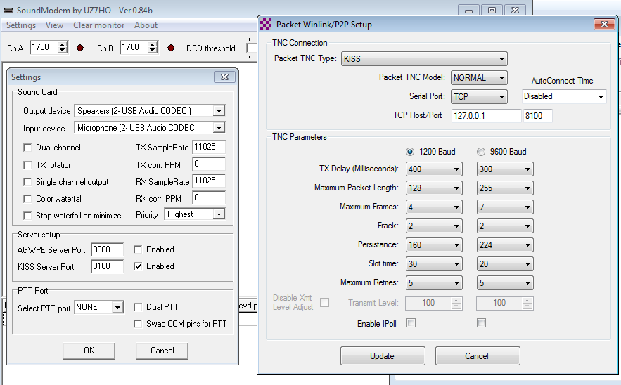
Initial Packet Setup Sound Card Interface (UZ7HO)

Slide 19
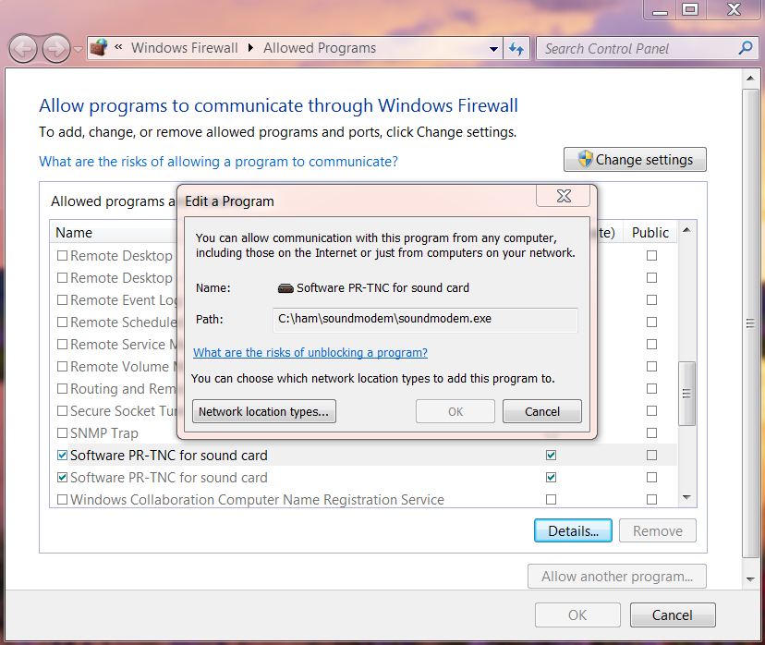
Initial Packet Setup Sound Card Interface (UZ7HO)
UZ7HO and Direwolf both
create “KISS TNC” servers within the network stack, ports on the firewall must be opened to allow RMS Express (and other applications) to use the virtual TNC.

Slide 20
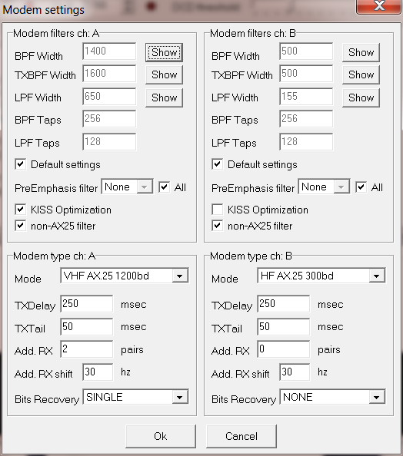
Initial Packet Setup Sound Card Interface (UZ7HO)
UZ7HO and Direwolf both
allow for multiple modems using a “stereo” sound card, for Signalink, only modem “A” is available. Set to 1200bd AX.25 modem.

Slide 21
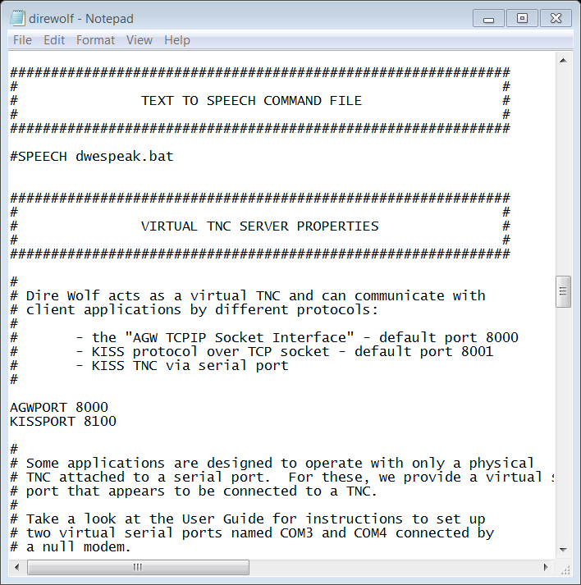
Initial Packet Setup Sound Card Interface (Direwolf)

Slide 22
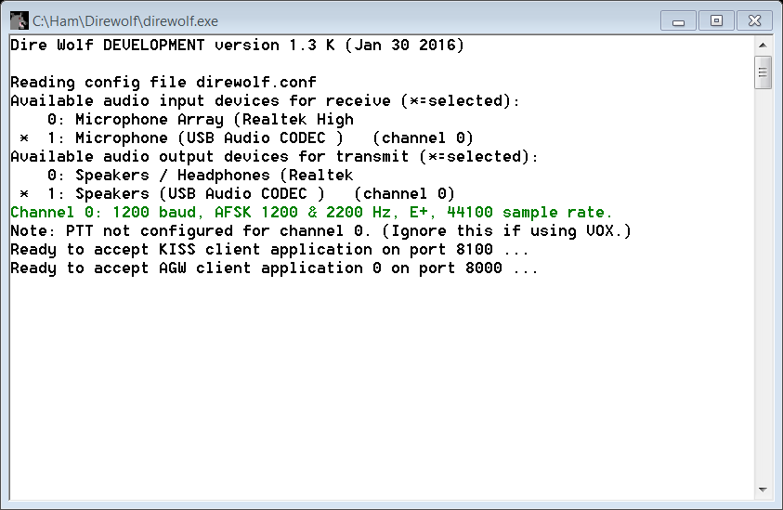
Initial Packet Setup Sound Card Interface (Direwolf)
Direwolf startup shows available audio devices. Signalink shows as USB Audio Codec

Slide 23
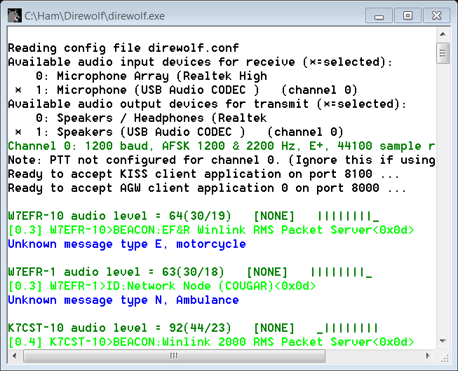
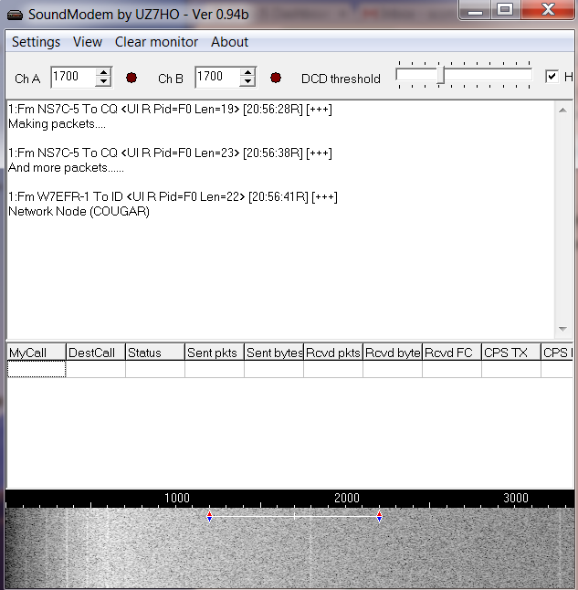
Initial Packet Setup Sound Card Virtual TNC

Slide 24
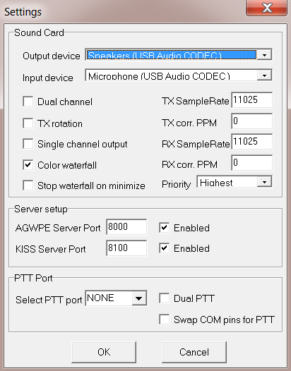
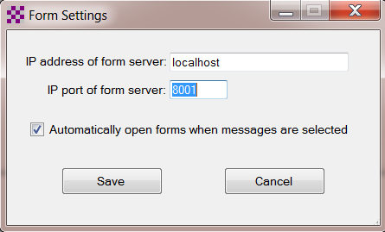
Initial Packet Setup Sound Card Virtual TNC
Make sure your Virtual TNC server TCP ports do not conflict with the RMS Express forms server.

Slide 25
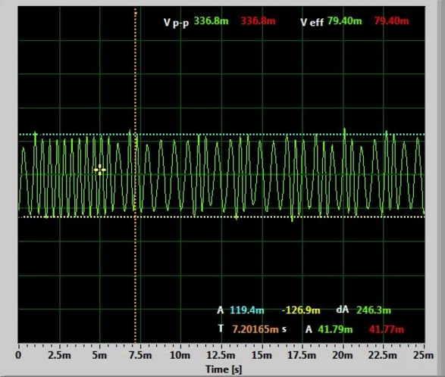
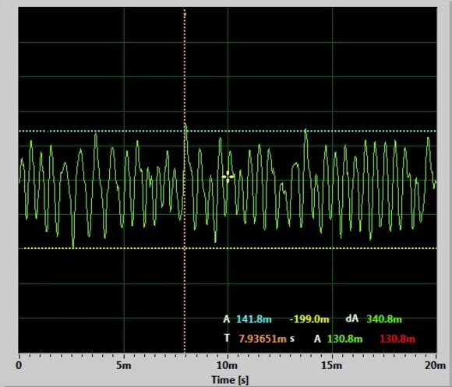
Initial Packet Setup Set your transmit levels correctly! (It is not plug and play)
http://www.febo.com/packet/layer-one/transmit.html
http://www.zeitnitz.de/Christian/scope_en

Slide 26
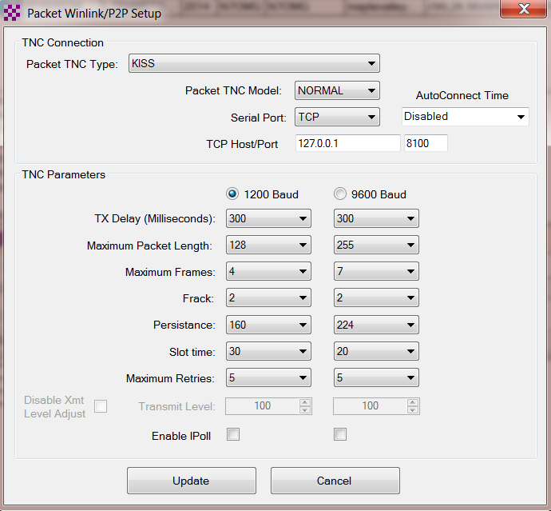
Initial Packet Setup Important Parameters
TX Delay (TXD)
Packet Length
Max Frames
Frack
Max Retries
AutoConnect Time
Note: For soundcard configurations, TXD is set in the Software TNC application.

Slide 27
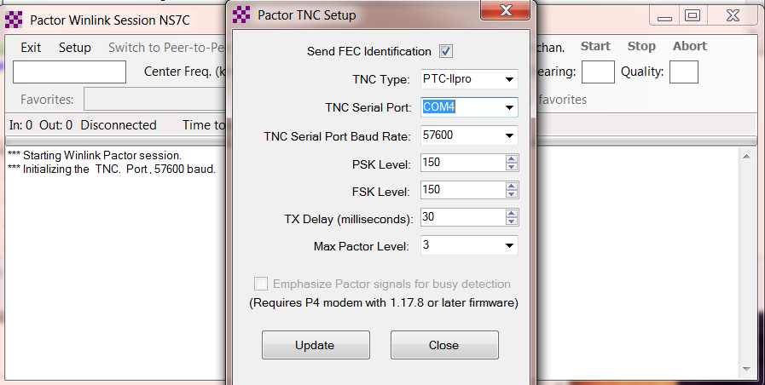
Initial Pactor Setup PTC modem

Slide 28
Resources Needed for RMS Express HF Winmor
Same computer and software requirements as V/UHF Packet. Winmor modem is included with RMS Express.
ITSHF propagation prediction program. Note, you will be prompted to download this on first Winmor run. A link to the software will be provided.
HF radio with data (sound) port and optionally computer control (CI/V, CAT, etc. for rig control).
SignaLink or similar soundcard interface, may be built-in on newer radios.
All software is free, donation is suggested.

Slide 29
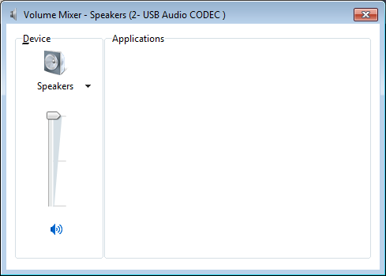
Configuring Sound Levels Watch drive/ALC levels on transmitter
Set to Max
Note:
Adjust SignaLink TX level for
minimum or no ALC action on HF transmitter

Slide 30
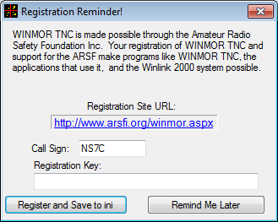
Winmor Registration Screen
Appears each time you start Winmor until you register and get a key.

Slide 31
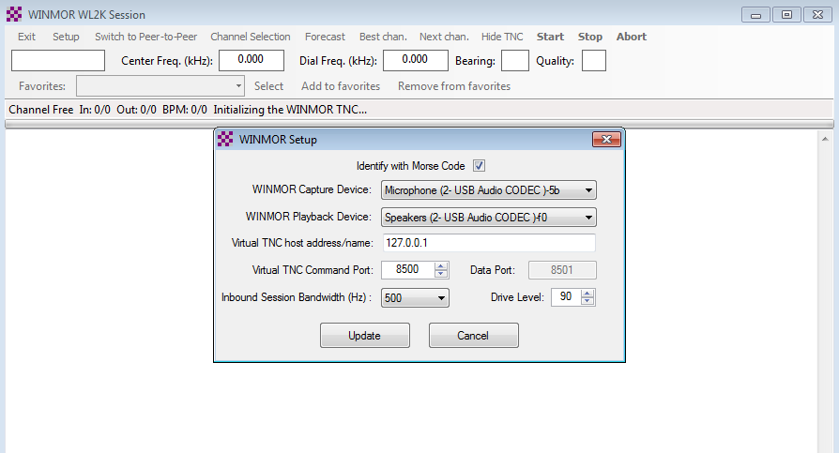
Initial Winmor Setup Selecting the Audio Device

Slide 32
Winmor Radio Setup Rig Control Parameters

Slide 33
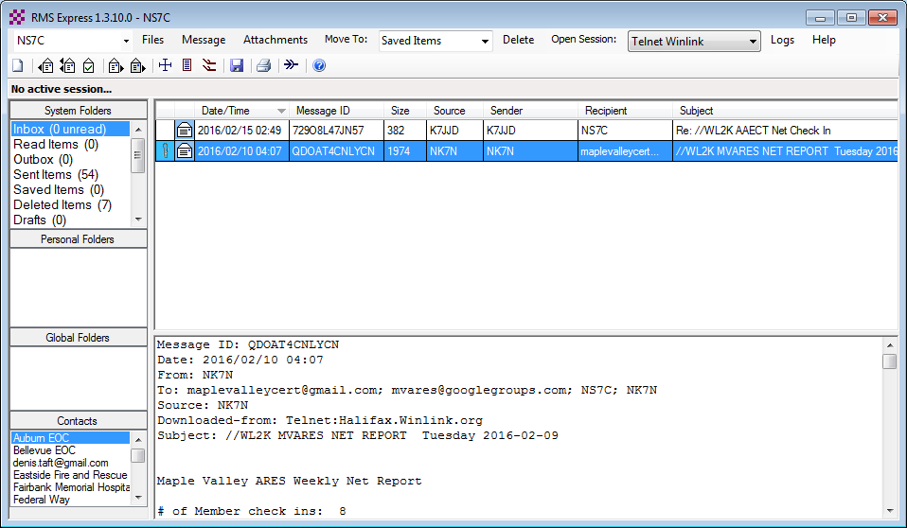
RMS Express Main Screen
Begin connection
Connection Mode
.
Multiple call signs
Standard
Folders
Personal message folders
Contacts address book

Slide 34
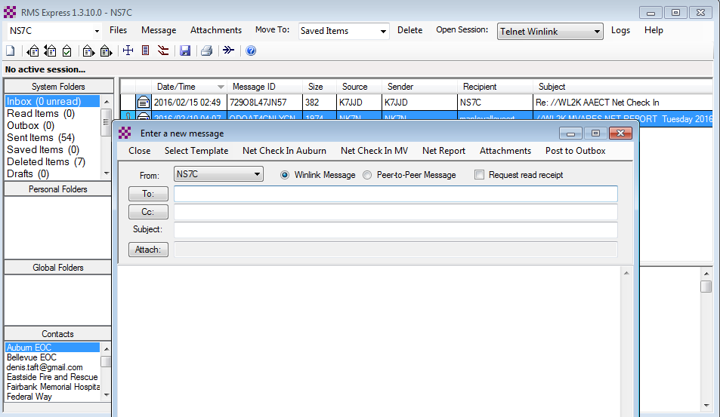
Composing A Message
Post to Outbox
New Message Button
Click “To” or “CC” for contacts
Multiple recipients and CC
Request
Read
Receipt
File attachments

Slide 35
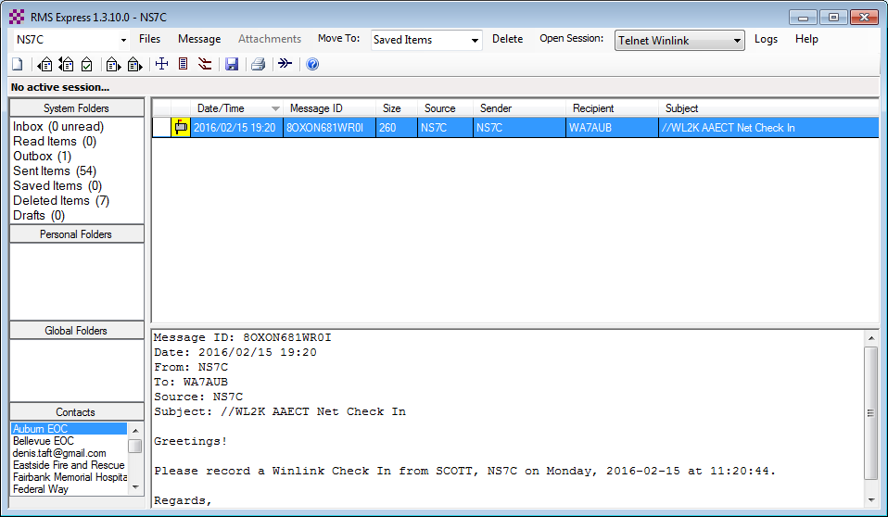
Pending Message In Outbox
Open Session

Slide 36
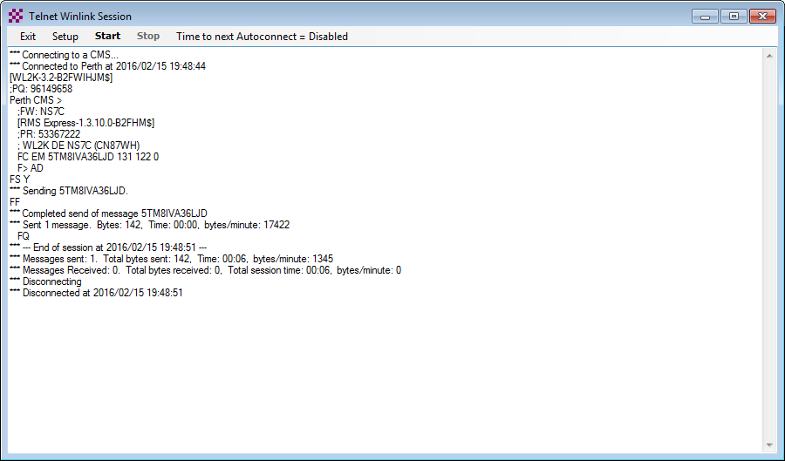
Telnet Session
Connect, login, send message, log off
Successful connections end with FF and FQ commands, followed by a disconnect. If these are missing, the session failed and must be retried.

Slide 37
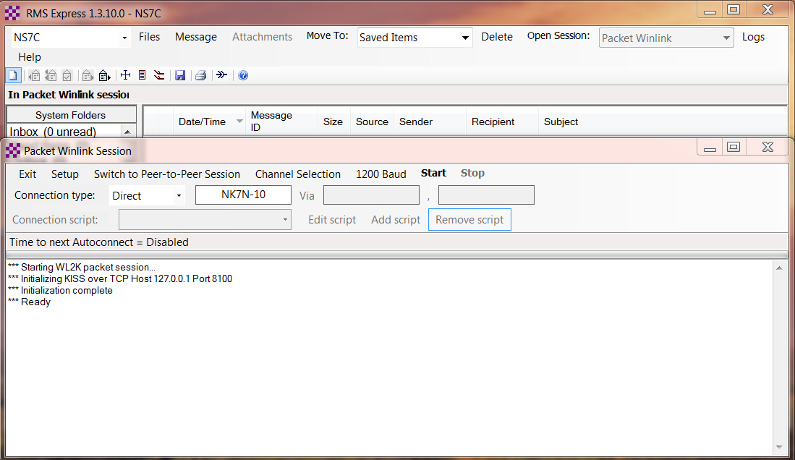
Packet Radio Session
Select Mode and Open Session

Slide 38
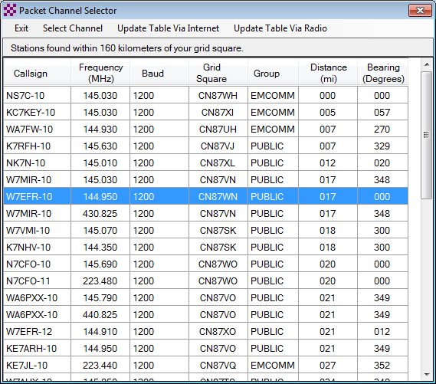
Packet Channel Selection Based on your grid square

Slide 39
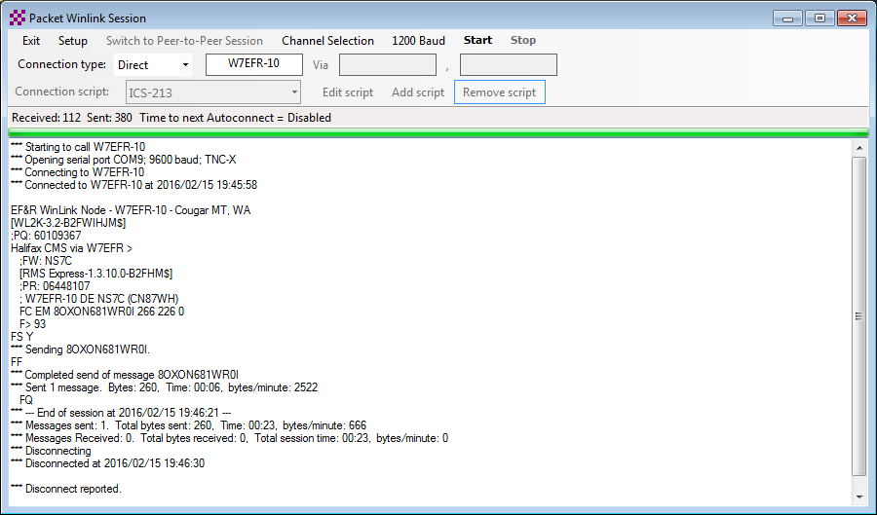
Packet Session (TNC)
Connect, login, send message, log off

Slide 40
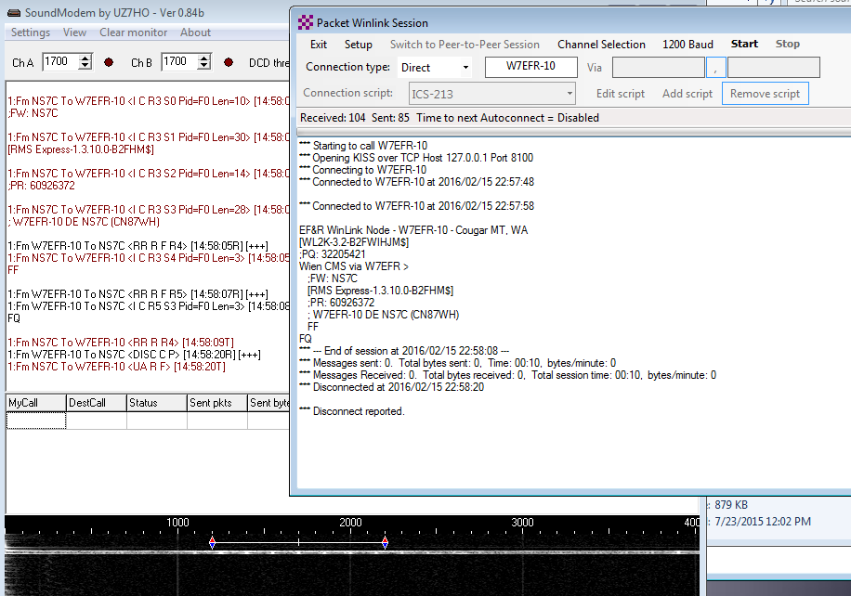
Packet Session (sound card)
Connect, login, check for message, log off

Slide 41
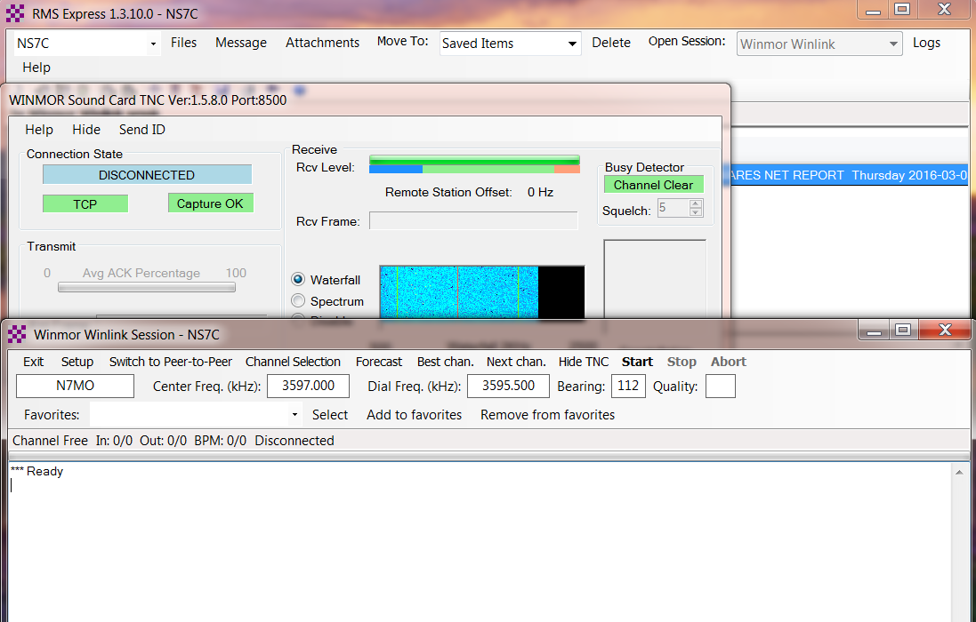
Winmor HF Session

Slide 42
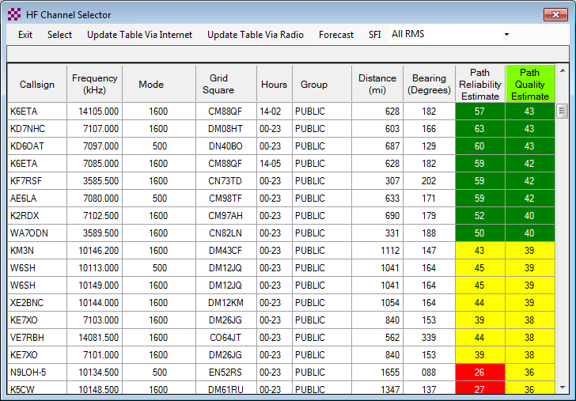
HF Channel Selection Screen
All RMS or radio-only
Click Header to Sort
Update channel list
Double click to select
Green: good Yellow: fair Red: bad

Slide 43
Check If Channel Is Free
Free Channel:
Busy Channel:

Slide 44
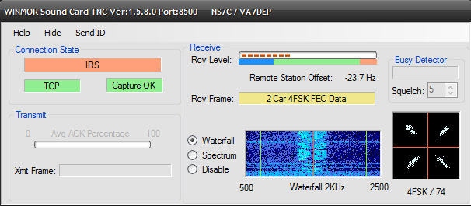
Active Winmor Connection

Slide 45
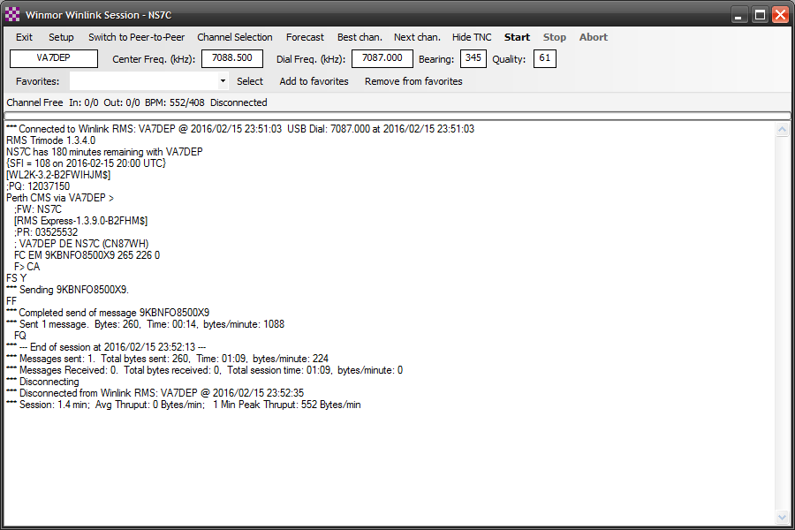
Winmor Session Log
Connect, login, send message, log off

Slide 46
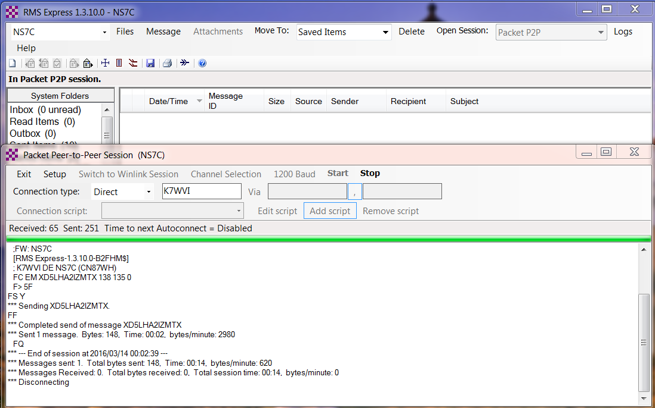
Packet P2P Session Log
Connect, login, send message, log off
Must match message destination

Slide 47
Conclusion
RMS Express use continues to grow, especially for EmComm.
The Winlink Development Team continues to enhance capabilities to adapt to changing needs.
Installation and set up is relatively easy.
Familiar “e-mail” like interface.
Supports multiple radio transfer modes.
Support for both hardware and software interfaces.

Slide 48
Follow on sessions
Session 3 on Sunday afternoon will focus on the operation of RMS Express in the EMCOMM environment, and possible future developments.
Questions?

