Slide 2
What Winlink offers for EMCOMM
Flexibility:
Internet-only (Telnet) direct connections to Winlink.
Radio link bridge to Internet e-mail.
Radio-only store and forward messaging.
Peer-to-peer connections between radio end-users.
Familiar and simple e-mail client interface.
Interoperability: Connect different types of systems
Bridge different radio capabilities (VHF/UHF/HF).
Seamless integration with Internet e-mail.
Geographical dispersion and redundancy for reliability

Slide 3
What Winlink offers for EMCOMM (more)
Standard e-mail format with many features.
Binary file attachments (pictures, pdf, spreadsheets).
Automatic message compression/decompression.
White listing used to prevent spam.
Time independence.
Ability to collect messages while unattended.
Good operation at most power levels.
Not limited by station-to-station propagation.
Message logging, and ICS report generation.
Forms and template support.
Wide adoption by EmComm related agencies.

Slide 4
Winlink Connection Modes
Telnet – Non-radio connection through the Internet. Good
for training (no radio equipment required) and use if radio is down or network is busy.
VHF/UHF Packet (local LOS propagation) –
9600 baud – Fast, reliable, range limited and requires $400
modem (Kantronics or SCS Tracker).
1200 baud – Slower, but can use inexpensive Byonics TinyTrak-4, TNC-X, or soundcard modems.
HF WINMOR – “Poor man’s Pactor”. Not as good as Pactor, but operates with inexpensive sound card device ($100), speed between Pactor 2 and 3.
HF Pactor 1, 2, 3 and 4 – Fast and reliable but requires an expensive modem ($1500+).

Slide 5
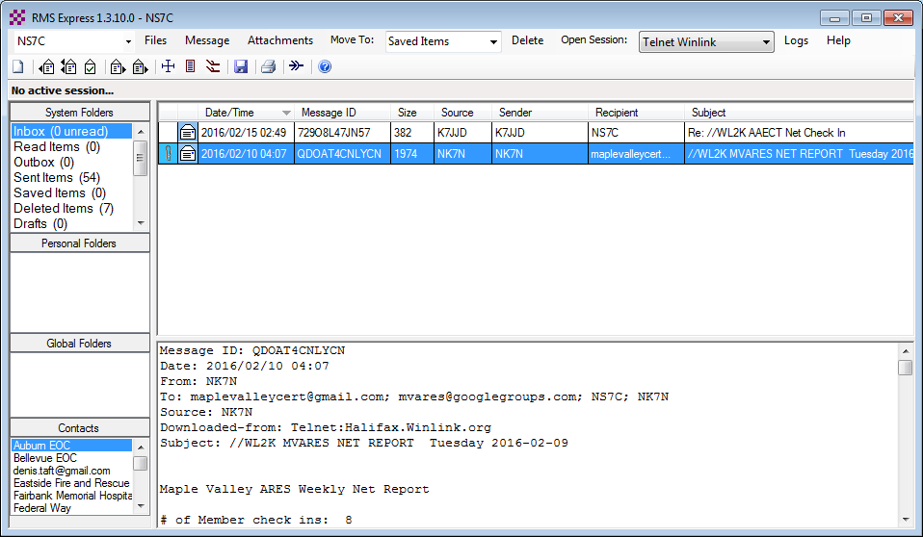
RMS Express Main Screen
Begin connection
Connection Mode
.
Multiple call signs
Standard
Folders
Personal message folders
Contacts address book

Slide 6
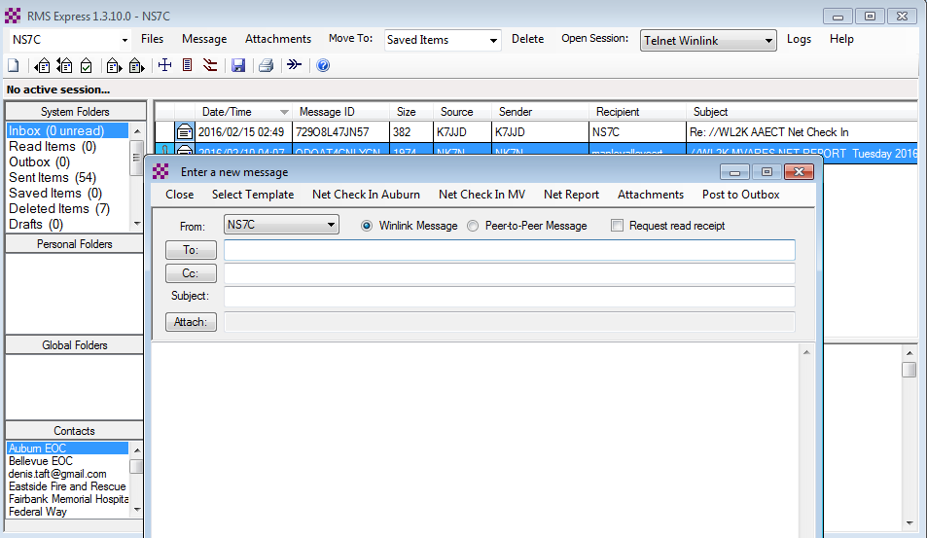
Composing A Message
Post to Outbox
New Message Button
Click “To” or “CC” for contacts
Multiple recipients and CC
Request
Read
Receipt
File attachments

Slide 7
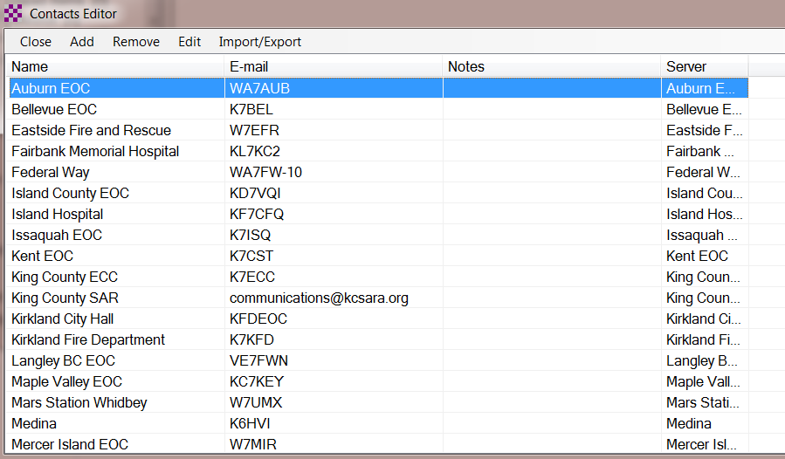
Address Book Support
Use of Standard Addresses for EMCOMM is Encouraged

Slide 8
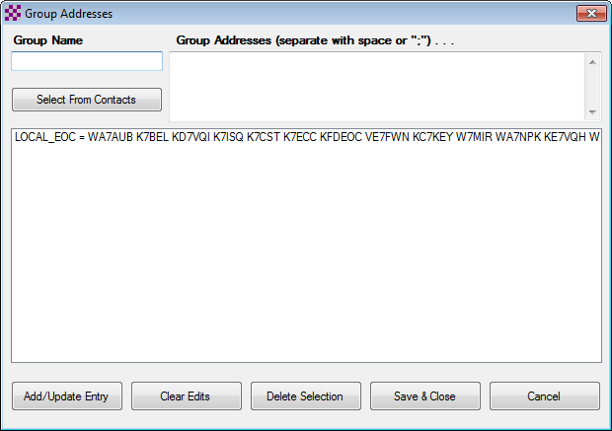
Using Group Addresses
Click “Files” followed by “Group Address…”
Use a group name in the “To” or “CC” fields

Slide 9
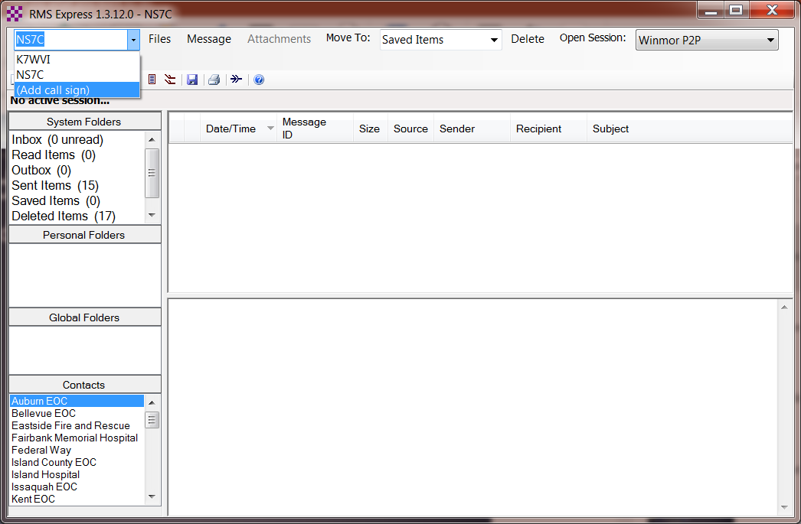
Tactical Address Support
Adding additional call signs

Slide 10
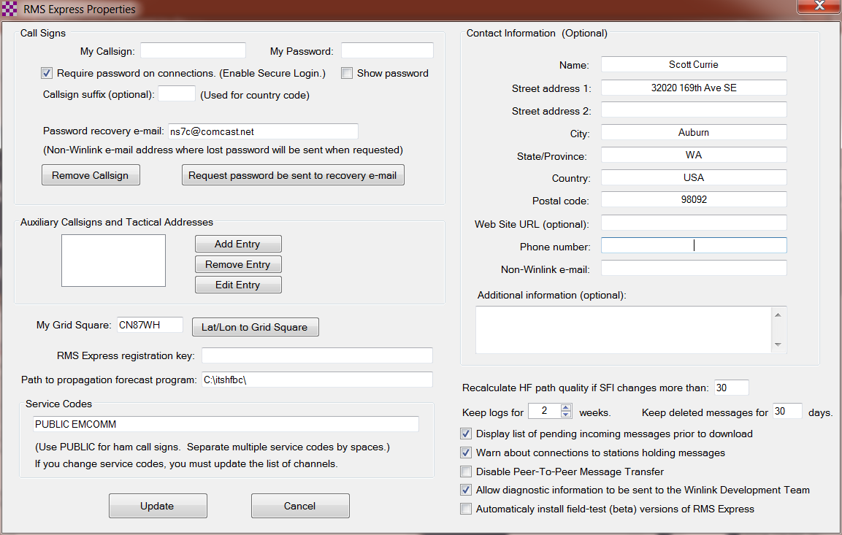
Tactical Address Support
Contact info will be duplicated, update or clear these fields

Slide 11
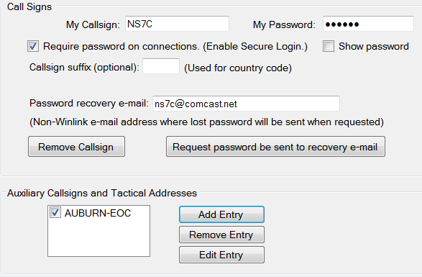
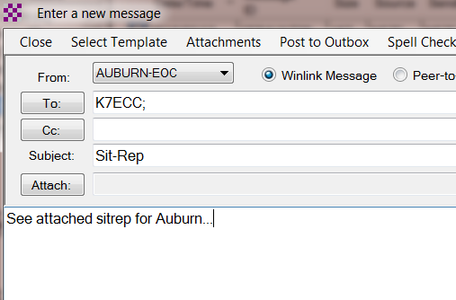
Tactical Address Support
Use of Tactical Addresses for EMCOMM is Encouraged

Slide 12
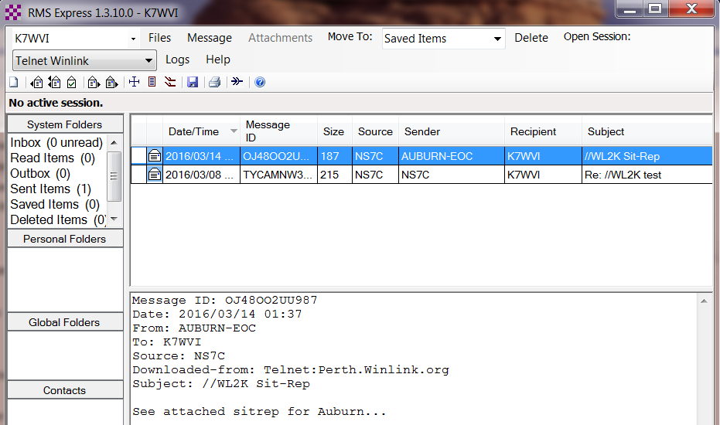
Tactical Address Support
Use of Tactical Addresses for EMCOMM is Encouraged

Slide 13
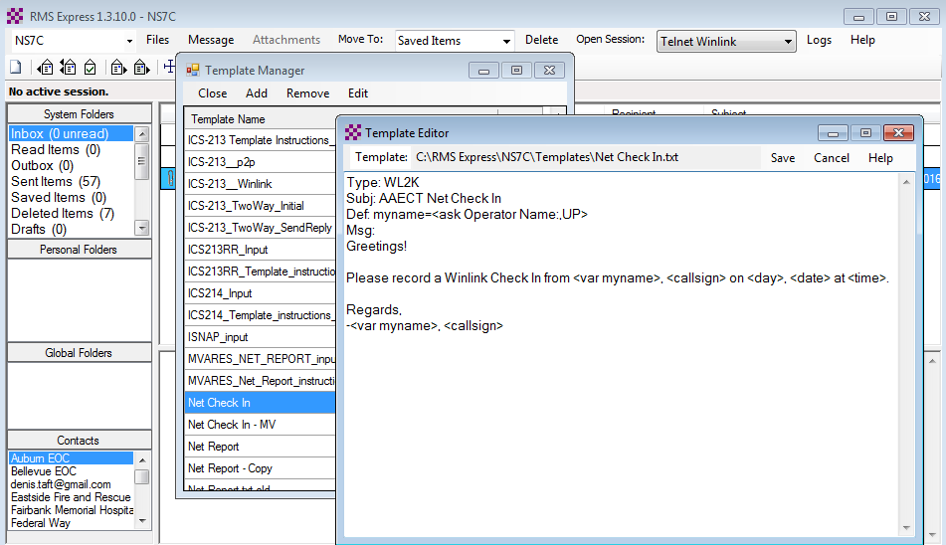
Creating Message Templates
Fills in “boilerplate” information for messages
Click “Message” followed by “Templates…”

Slide 14
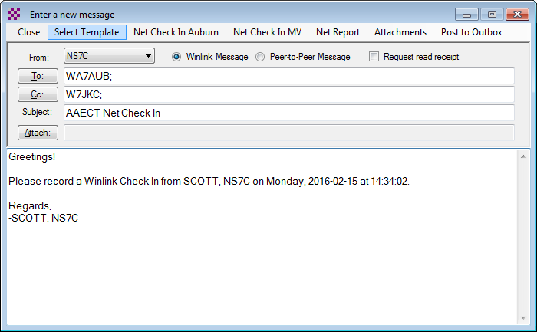
Using a Message Template
Begin composing a message
Click “Select Template” and select the template
Click to select a template
CC and subject filled in automatically
Favorite templates
Body initialized from template

Slide 15
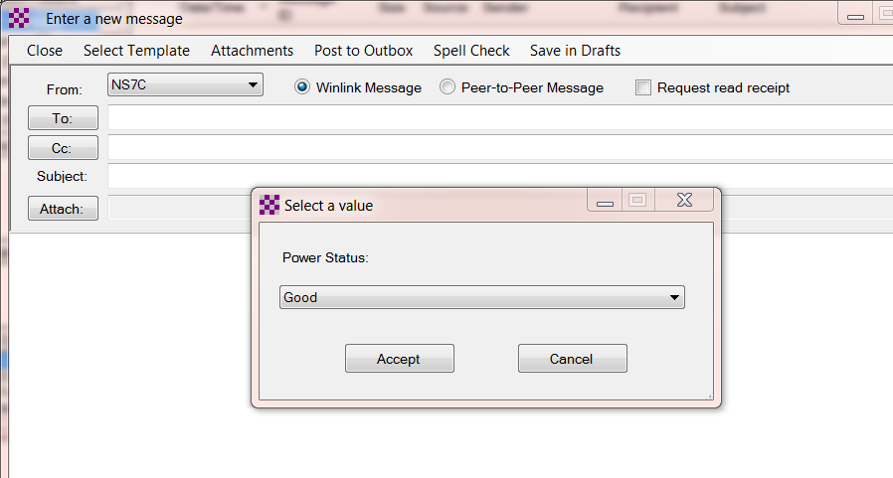
Using a Message Template
Prompting for input

Slide 16
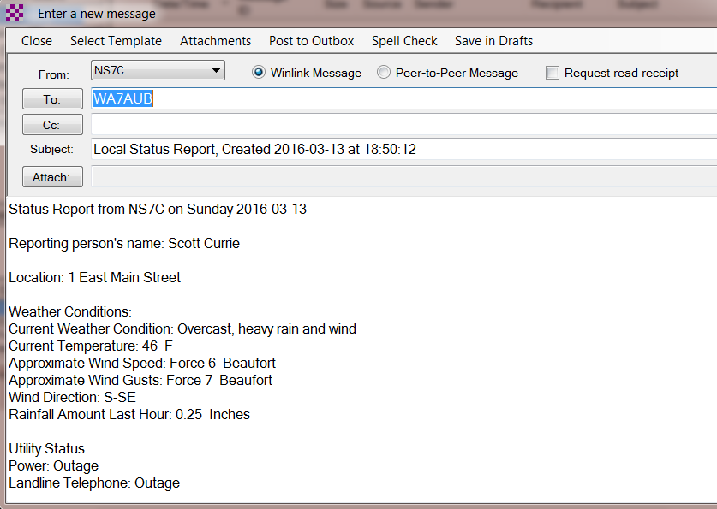
Using a Message Template
Completed message ready to send

Slide 17
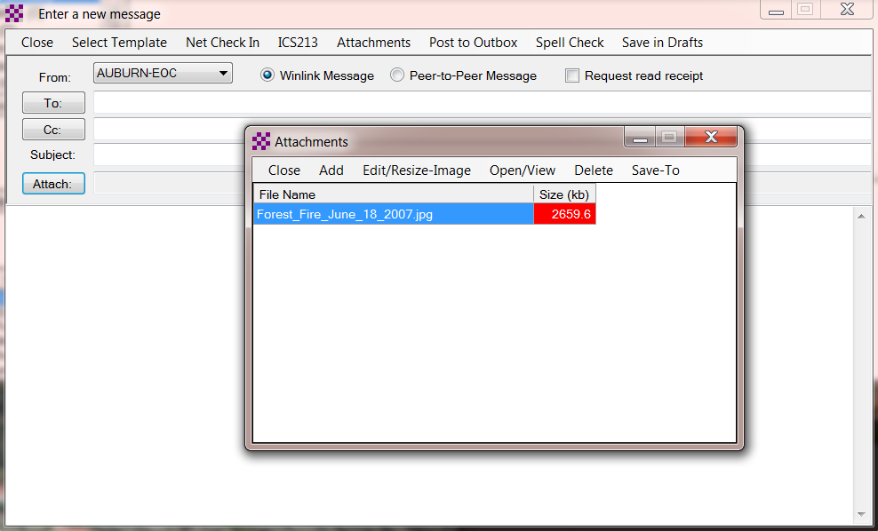
Message Attachments
File size must be managed

Slide 18
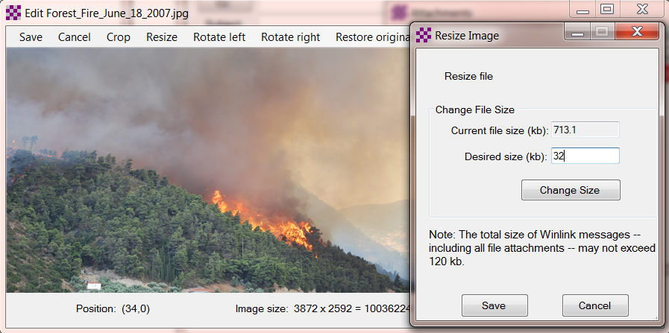
Message Attachments
Resize and crop pictures within RMS Express

Slide 19
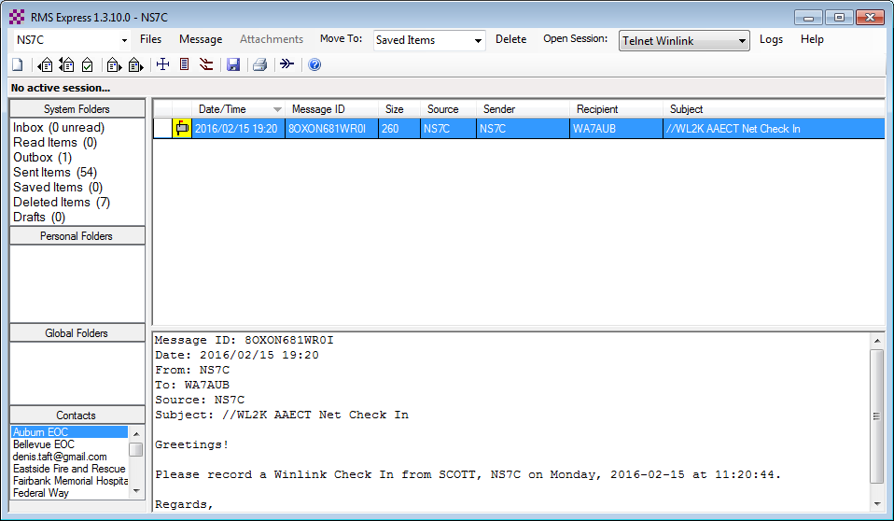
Pending Message In Outbox
Open Session

Slide 20
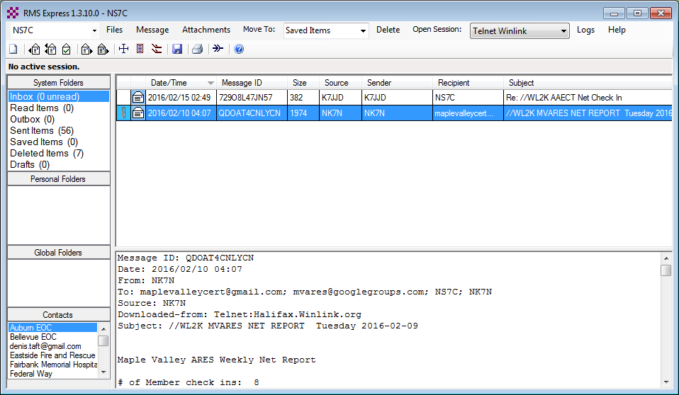
Reading Incoming Messages

Slide 21
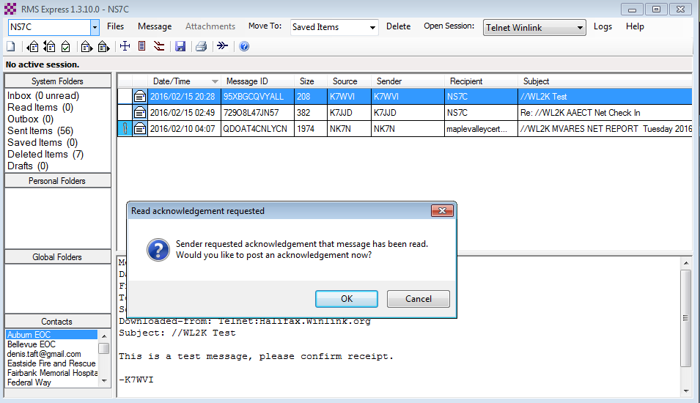
Notification of Read Acknowledgement

Slide 22
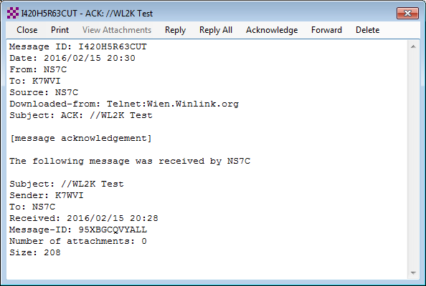
Message Receipt Acknowledgements
Positive acknowledgment that message was received
Information about message filled in automatically

Slide 23
RMS Express Message Review
Review pending messages before downloading.
Select which messages to download.
Message too large & not wanted

Slide 24
RMS Express HTML Forms
HTML forms are efficient and professional looking.
Forms can be simple or very complex.
Forms can look as good as any web site.
Forms are easy to use.
Attractive forms are difficult to create unless you understand HTML, cascading style sheets and JavaScript.
The Winlink team is building a library of forms.
Good HTML/JavaScript programmers are needed!

Slide 25
HTML Form and Template Set
A full form set has three components:
A template that displays the form and generates the text message to be sent.
An input form that solicits input from the user.
A display form that formats and displays the information on the recipient’s computer.
Input from a form is encapsulated in a compact XML file attached to the message.
The actual form HTML is not transmitted.
Input and display forms may be large, but the actual data transmitted is very compact.
Receiving station must have the display form installed.

Slide 26
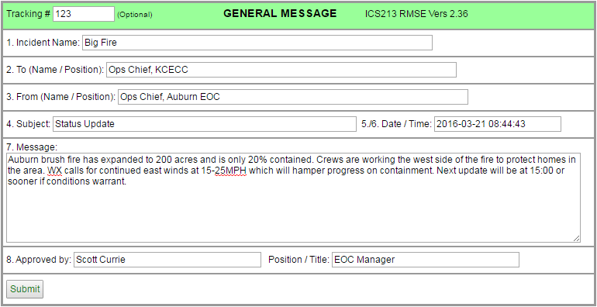
RMS Express Forms ICS form for data entry in browser

Slide 27
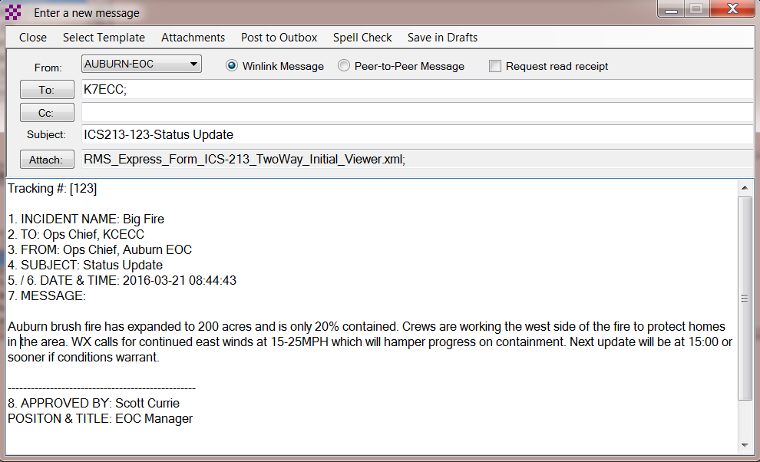
RMS Express Forms Completed form ready to send
Captured data entry
Plain text version

Slide 28
Available RMS Express Forms (ICS)
ICS 205 V1.26 Incident Communications Radio Plan
ICS 205A V1.4 Communications List
ICS 206 V2.1 Medical Plan
ICS 213 V2.36 General Message
ICS 213RR V1.3 Resource Request Message
ICS 214 V2.2 Activity Log
ICS 217A V1.6 Communications Resource Availability Worksheet
All ICS forms are now available in one zip file: http://winlink.org/content/all_ics_forms_one_zip_file_v11

Slide 29
Available RMS Express Forms (general)
HICS-ICS213 V2.6 General Message
IARU V1.17 Radiogram
ISNAP V1.0 Incident Snapshot for Counties / Tribal Nations
RMSE V1.5 Hospital Bed Report (Marion County FL)
RMSE V1.1 Clay County FL ICS 213
RMSE V1.4 POD General Message Form
RMSE V1.5 Bulletin Form
RMSE V1.5 Simple Message
RMSE V1.6ES Simple Message Spanish Version
RMSE V1.8 Float Plan
RMSE V2.0 Winlink Operator Check In

Slide 30
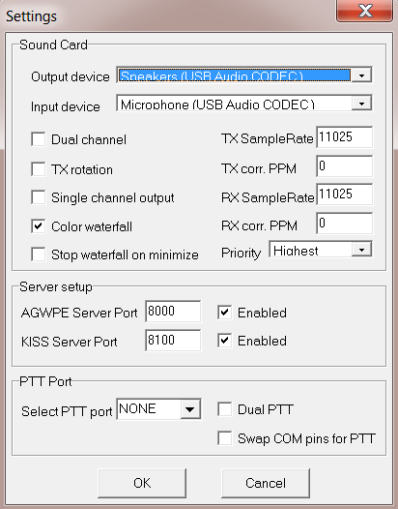
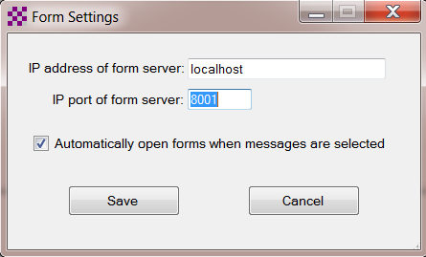
Initial Packet Setup Sound Card Virtual TNC
Make sure your Virtual TNC server TCP ports do not conflict with the RMS Express forms server port.

Slide 31
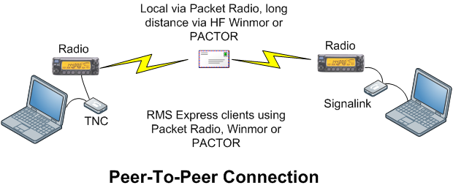
Winlink Peer-To-Peer Radio-Only Operation
Peer-to-peer: direct radio connection between end-users.
The Internet is not used, all communication by radio.
Only the two client stations are involved.
100% error-free transmission and file attachments.

Slide 32
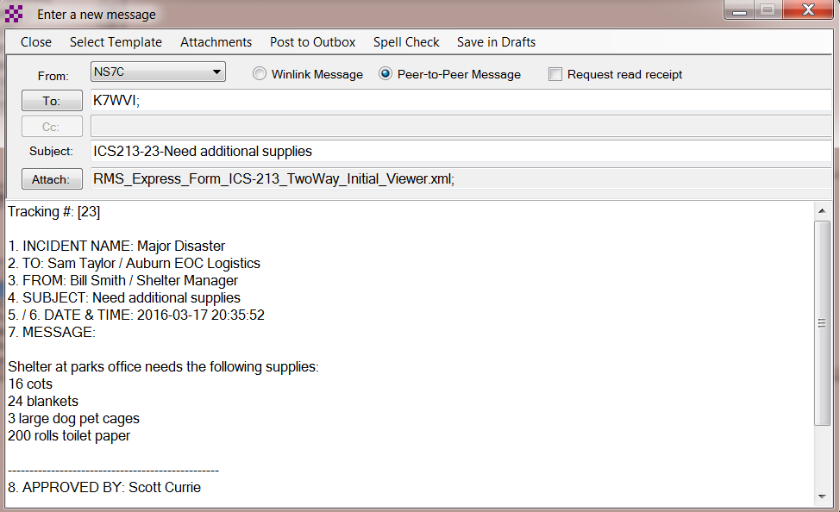
P2P Message
Set to P2P, addressed to receiving station
Must be addressed to P2P partner

Slide 33
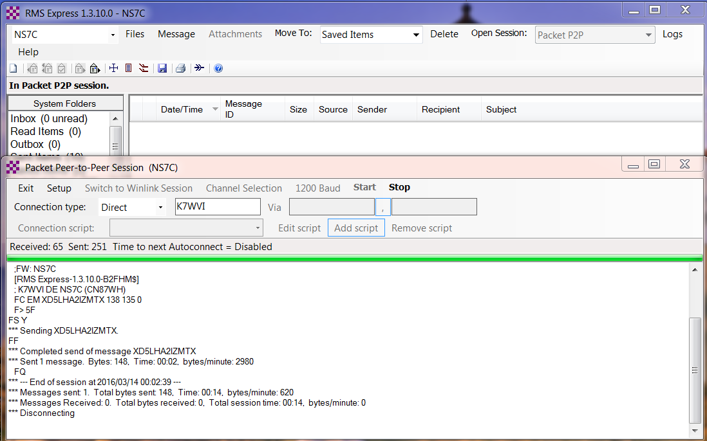
Packet P2P Session Log
Connect, login, send message, log off

Slide 34
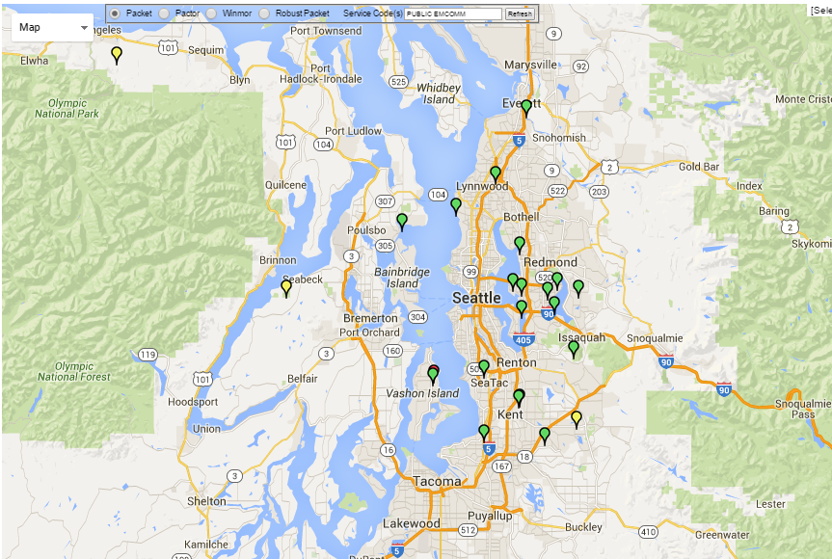
Using the Local Network
Local Packet Gateway Stations

Slide 35
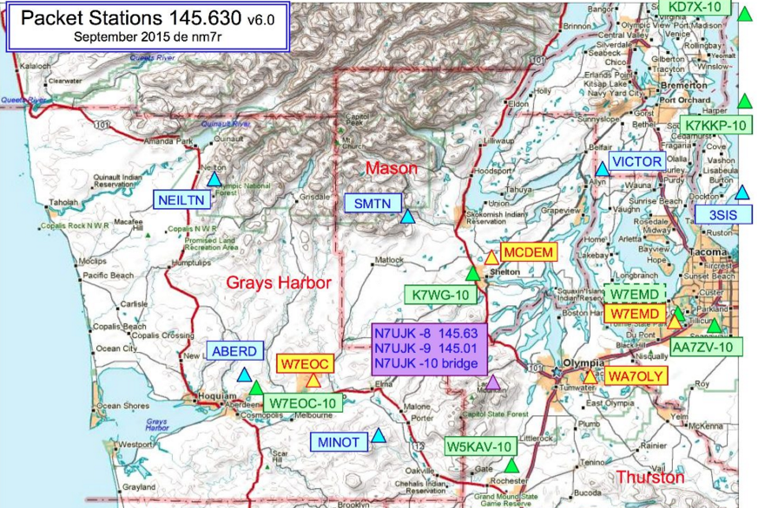
Using the Local Network
Local Packet Gateway Stations, nodes and digipeaters

Slide 36
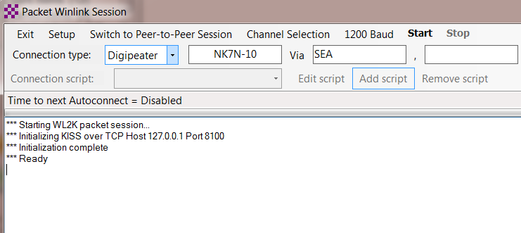
Using the Local Network
Digipeaters and Nodes
Digipeaters can be used to extend the line-of-sight path to a Gateway or P2P partner. Any station can function as a digi if properly configured. Lower level sites are actually better than mountain top sites. Each hop through a digi decreases performance, multiple hops can slow transfer speeds considerably.

Slide 37
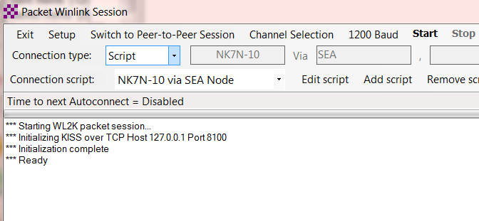
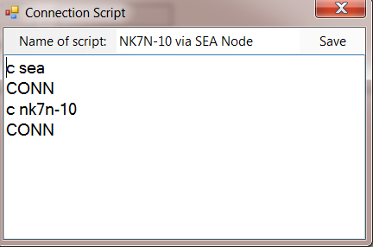
Using the Local Network
Digipeaters and Nodes
Complex connections through Nodes can be created using connection scripts. Scripts issue commands and wait for the appropriate response. Nodes provide better performance over multi-hop paths, but there is still a significant performance penalty.
Scripts can be simple or very complex. Detailed knowledge of the network is required.

Slide 38
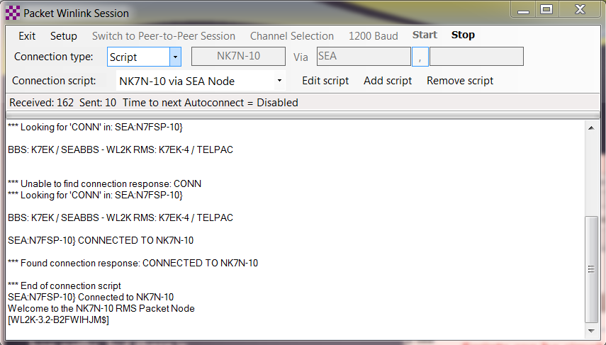
Using the Local Network
Digipeaters and Nodes
Waiting for the correct response
These are expected errors parsing for the correct response
End of script, the connection now continues normally

Slide 39
Using the Local Network
Digipeaters and Nodes
Using nodes and digis has a significant impact on throughput
Requires a good knowledge of available resources
May require adjustment of packet parameters
Be aware of the “hidden terminal” issue
Full duplex digital repeaters are a better solution
There is only 1 available, in Snohomish
You cannot run voice and data on the same band at the same time from the same location. We need to have voice and data on different bands.

Slide 40
Winlink Radio-Only Network Local networks connected by HF, regional or long distance
Geographically
Separated
Local Users
Local Users
Local Users

Slide 41
Catalog Information Requests
Use the “Winlink Catalog Request” feature in RMS
Express to request:
Weather maps for most areas of the world.
Weather forecasts.
Maritime HF nets and frequencies.
Satellite images.
Location of closest 30 stations.
ARRL Newsletter, e-letter, etc.
Misc. bulletins.

Slide 42
RMS Express Query Catalog

Slide 43
Weather Map Image Returned for Request

Slide 44
Winlink Position Reports
You can send position reports to the Winlink system.
Coordinates sent via connected GPS.
Otherwise, your position may be entered manually.
Position Reports are sent to:
Winlink system map.
ShipTrak maps.
APRS maps.
YotReps maps.
Extremely valuable for pinpointing locations, especially for maritime operation.

Slide 45
Posting a Position Report
Data from a connected GPS unit.
Useful in tracking with e-mailed disaster assessments.
WX
assistance to the NWS Voluntary Marine Observation Program.

Slide 46
Winlink.org Real-time Position Report Page

Slide 47
RMSMessageLog ICS-309 Generator
Messages during period
Select folders
Starting & ending report period
Generate ICS-309
pdf file

Slide 48
Generated ICS-309 PDF Message Log Report

Slide 49
Future Development Amateur Radio Digital Open Protocol (ARDOP)
The ARDOP project is a joint development effort among amateur radio developers that seeks to provide a specification and implementation (software or hardware) for a modern versatile open digital protocol.
Replaces Winmor, AX.25 Packet, ???
Soundcard based, or open hardware platform

Slide 50
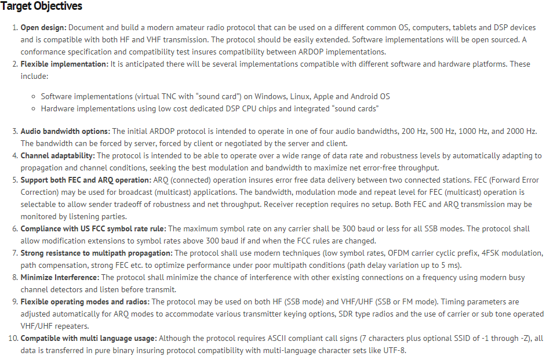
Future Development Amateur Radio Digital Open Protocol (ARDOP)

Slide 51
Conclusion
Winlink use continues to grow, especially for EmComm.
The Winlink Development Team continues to enhance capabilities to adapt to changing needs.
RMS Express is the recommended client application
Familiar e-mail like user interface
Flexible connection options
HTML form support
Used by most local teams

