Slide 2
What is Winlink
Worldwide system for sending e-mail via radio.
Provides e-mail from almost anywhere in the world.
Entirely supported and operated by amateur radio volunteers (Amateur Radio Safety Foundation, Inc.).
Started as “SailMail” providing support for sailors.
Adopted for contingency communication by many government agencies.
Used by infrastructure-critical NGOs such as International & American Red Cross, Southern Baptist Disaster Relief, DHS Tiered AT&T Disaster Response & Recovery, FedEx, Bridgestone Emergency Response Team, etc.

Slide 3
What Winlink offers for EMCOMM
Flexibility:
Internet-only (Telnet) direct connections to Winlink.
Radio link bridge to Internet e-mail.
Radio-only store and forward messaging.
Peer-to-peer connections between radio end-users.
Familiar and simple e-mail client interface.
Interoperability: Connect different types of systems
Bridge different radio capabilities (VHF/UHF/HF).
Seamless integration with Internet e-mail.
Geographical dispersion and redundancy for reliability

Slide 4
What Winlink offers for EMCOMM (more)
Standard e-mail format with many features.
Binary file attachments (pictures, pdf, spreadsheets).
Automatic message compression/decompression.
White listing used to prevent spam.
Time independence.
Ability to collect messages while unattended.
Good operation at most power levels.
Not limited by station-to-station propagation.
Message logging, and ICS report generation.
Forms and template support.
Wide adoption by EmComm related agencies.

Slide 5
Winlink System Architecture
Hierarchal levels of the Winlink system:
Client system – Radio, computer with Winlink software (RMS Express), TNC (or sound card) and you, the end-user!
Radio Message Server (RMS) – Radio gateway between
the client (end-user) and the Winlink system backbone.
Common Message Servers (CMS) – Winlink backbone.
5 CMS locations,
redundant, fault-tolerant
located on 3 continents
One CMS sufficient for operation

Slide 6
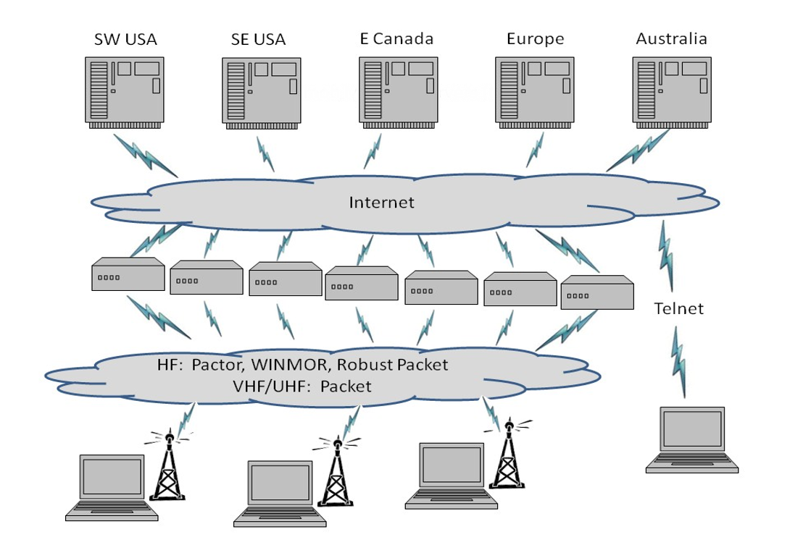
Winlink Normal Network Operation
CMS
RMS
(gateways)
Client
(you)

Slide 7
Winlink System Architecture
Client users connect to gateway stations over RF (local or long distance).
Gateway stations then connect to the CMS via the Internet.
Local RF connections can be direct to the gateway, or use digital repeaters and/or network nodes to extend LOS range.
Radio-Only “mesh” networks can be built where the gateway stations operate as message servers and do not use the internet. This creates a “local LAN” which can then be connected to other LANs via HF forwarding, regional or long distance.
Direct peer-to-peer connections between clients are also supported, both local and long distance.

Slide 8
Winlink Radio-Only Network Local networks connected by HF, regional or long distance
Geographically
Separated
Local Users
Local Users
Local Users

Slide 9
Winlink Peer-To-Peer Radio-Only Operation
Peer-to-peer: direct radio connection between end-users.
The Internet is not used, all communication by radio.
Only the two client stations are involved.
100% error-free transmission and file attachments.

Slide 10
Winlink Connection Modes
Telnet – Non-radio connection through the Internet. Good
for training (no radio equipment required) and use if radio is down or network is busy.
VHF/UHF Packet (local LOS propagation) –
9600 baud – Fast, reliable, range limited and requires $400
modem (Kantronics or SCS Tracker).
1200 baud – Slower, but can use inexpensive Byonics TinyTrak-4, TNC-X, or soundcard modems.
HF WINMOR – “Poor man’s Pactor”. Not as good as Pactor, but operates with inexpensive sound card device ($100), speed between Pactor 2 and 3.
HF Pactor 1, 2, 3 and 4 – Fast and reliable but requires an expensive modem ($1500+).

Slide 11
Levels of Message Validation & Correction
No validation or correction – RTTY, BPSK-31.
Forward Error Correction (FEC) – Redundant information transmitted so minor errors can be corrected: MT63, Olivia, QPSK-31.
Automatic Repeat Request (ARQ) – Positive or negative packet acknowledgements from receiving station: Pactor, Winmor, Packet, TCP/IP.
Pactor and Winmor use both FEC and ARQ.
Only ARQ provides 100% accurate message delivery.
Accuracy is essential for EmComm.

Slide 12
Resources Needed for RMS Express VHF/UHF Packet Radio
Computer running Windows XP through Windows 10.
.NET 3.5 framework.
RMS Express program.
V/UHF radio with data port (1200/9600) or speaker/mic connection (1200 only).
SignaLink or similar USB soundcard interface, or Packet TNC (Kantronics, TNC-X, MFJ, etc.). Might require a USB to Serial dongle.
Note: Some new radios have built-in soundcards/TNC’s.
Software downloads:
ftp://autoupdate.winlink.org/User%20Programs/
All software is free, donation is suggested.

Slide 13
SignaLink Soundcard Interface
Simple device powered by USB connection.
Cost is about $100 including radio-specific cable.
Radio needs to have a data (sound) port, or use microphone and speaker connections.
Need to run “Software TNC” application (Direwolf, UZ7HO soundmodem).

Slide 14
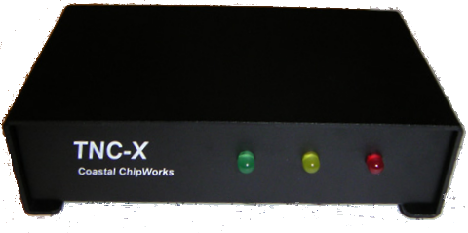
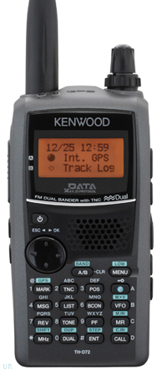
Packet TNC
Can be simple KISS mode, or full function.
Cost from about $100 to $1500.
Radio needs to have a data port (1200/9600), or use microphone and speaker connections (1200 only).
Some radios include a built-in TNC or sound card.

Slide 15
Installing RMS Express
Download zip file:
ftp://autoupdate.winlink.org/User%20Programs/
Extract the .msi installer from the zip file and run it.
Complete the setup screens (call sign, location, etc.).
Browse C:\RMS Express\, right click on.
RMS Express.exe and select option to create a shortcut.
Note: Winmor will be installed automatically.
Download propagation prediction program (for HF only) zip file, extract .exe installer file from zip file and run it.

Slide 16
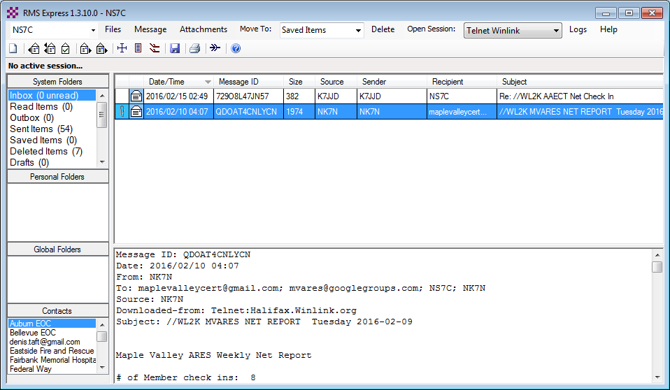
RMS Express Main Screen
Begin connection
Connection Mode
.
Multiple call signs
Standard
Folders
Personal message folders
Contacts address book

Slide 17
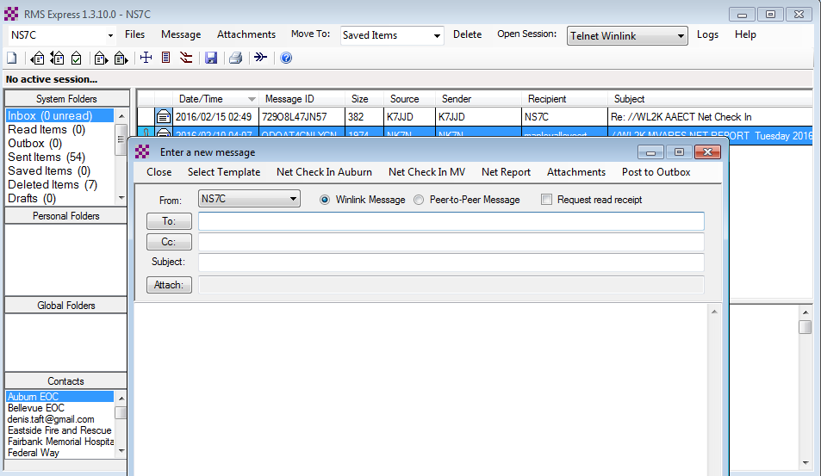
Composing A Message
Post to Outbox
New Message Button
Click “To” or “CC” for contacts
Multiple recipients and CC
Request
Read
Receipt
File attachments

Slide 18
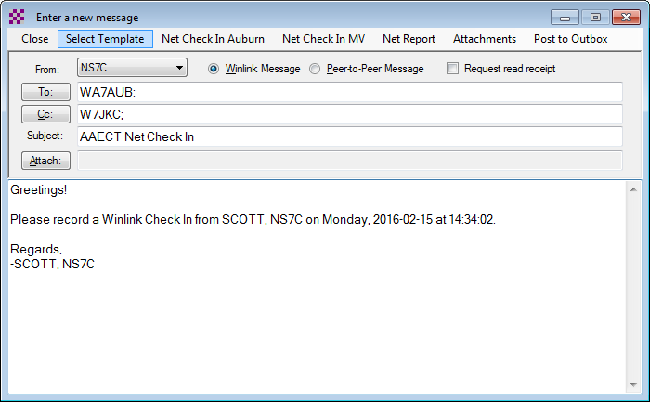
Using a Message Template
Begin composing a message
Click “Select Template” and select the template
Click to select a template
CC and subject filled in automatically
Body initialized from template

Slide 19
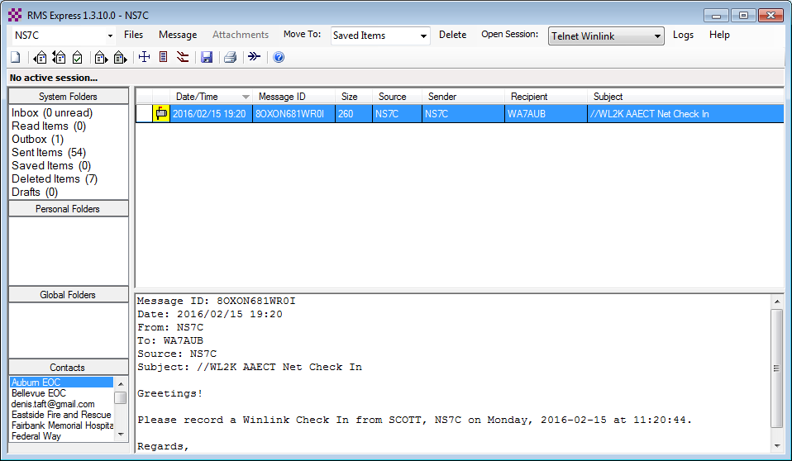
Pending Message In Outbox
Open Session
Once a message has been posted to the outbox, it remains there until a transfer session has been opened and started. Kind of like the old dial-up days.

Slide 20
Resources Needed for RMS Express HF Winmor
Same computer and software requirements as V/UHF connections.
ITSHF propagation prediction program.
HF radio with data (sound) port and optionally computer control (CI/V, CAT, etc. for rig control).
SignaLink or similar USB soundcard interface.
Note: Some new radios have built-in soundcards.
All software is free, donation is suggested.

Slide 21
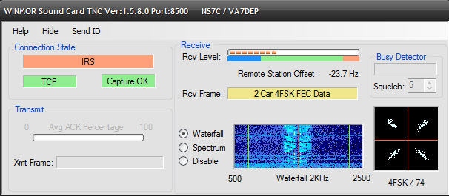
Active Winmor Connection
Similar modem interface as other HF digital modes.

Slide 22
RMS Express HTML Forms
HTML forms are efficient and professional looking.
Forms can be simple or very complex.
Forms can look as good as any web site.
Forms are easy to use.
Attractive forms are difficult to create unless you understand HTML, cascading style sheets and JavaScript.
The Winlink team is building a library of forms.
We need good HTML/JavaScript programmers.

Slide 23
HTML Form and Template Set
A full form set has three components:
A template that displays the form and generates the text message to be sent.
An input form that solicits input from the user.
A display form that formats and displays the information on the recipient’s computer.
The form itself is not transmitted, only the data entered on the form.
Forms may be very complex and feature rich, but the actual data transmitted is very compact.
Receiving station must have the display form installed for proper display, but they will still receive a text-only version.

Slide 24
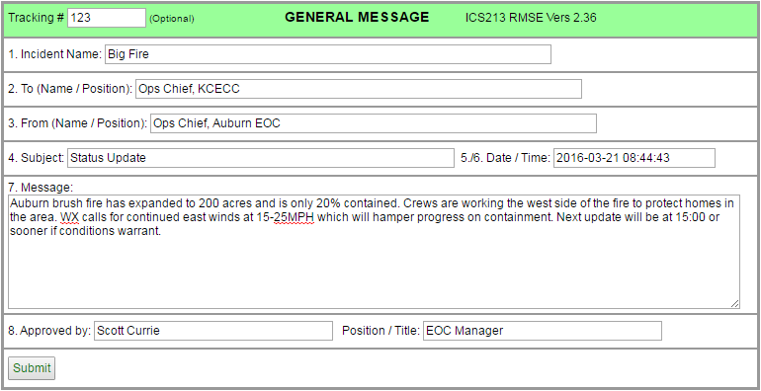
RMS Express Forms ICS form for data entry in browser

Slide 25
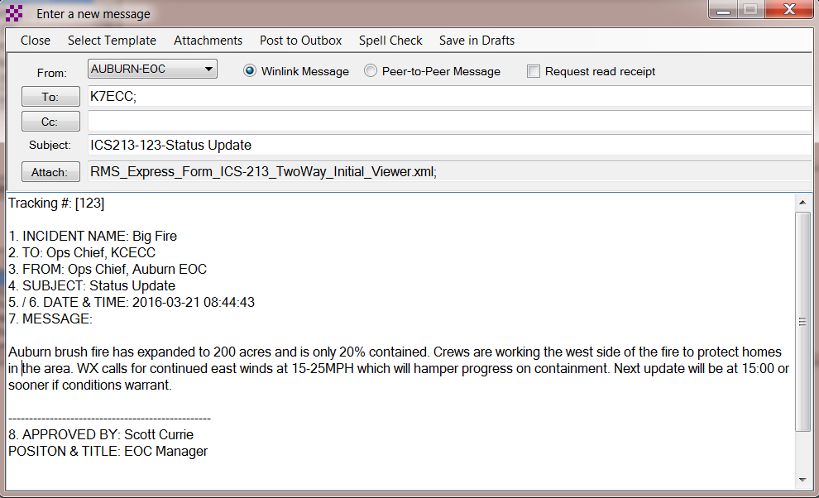
RMS Express Forms Completed form ready to send
Captured data entry
Plain text version

Slide 26
Available RMS Express Forms (ICS)
ICS 205 V1.26 Incident Communications Radio Plan
ICS 205A V1.4 Communications List
ICS 206 V2.1 Medical Plan
ICS 213 V2.36 General Message
ICS 213RR V1.3 Resource Request Message
ICS 214 V2.2 Activity Log
ICS 217A V1.6 Communications Resource Availability Worksheet

Slide 27
Available RMS Express Forms (general)
HICS-ICS213 V2.6 General Message
IARU V1.17 Radiogram
ISNAP V1.0 Incident Snapshot for Counties / Tribal Nations
RMSE V1.5 Hospital Bed Report (Marion County FL)
RMSE V1.1 Clay County FL ICS 213
RMSE V1.4 POD General Message Form
RMSE V1.5 Bulletin Form
RMSE V1.5 Simple Message
RMSE V1.6ES Simple Message Spanish Version
RMSE V1.8 Float Plan
RMSE V2.0 Winlink Operator Check In

Slide 28
Generated ICS-309 PDF Message Log Report

Slide 29
Conclusion
Winlink use continues to grow, especially for EmComm.
The Winlink Development Team continues to enhance capabilities to adapt to changing needs.
Winlink has three modes of operation to send and receive messages, even if the Internet is down:
RF connection through a gateway to a CMS Internet server.
Radio-only “MESH” network with HF relaying.
RF Peer-to-Peer connections between client stations.
Steady improvements are being implemented.

Slide 30
Follow on sessions
Session 2 this afternoon will focus on the technical details of installing and configuring RMS Express for V/UHF packet and HF Winmor operation using TNC’s and sound card modems.
Session 3 on Sunday afternoon will focus on the operation of RMS Express in the EMCOMM environment, and possible future developments.
Questions?

